Slide 1
Microcontroller/Microprocessor Based Systems

Slide 2
Intel 8255 Programmable Peripheral Interface
Outline
Pins
Modes
Interfacing with 8088/8086 CPU

Slide 3
Intel 8255 Programmable Peripheral Interface
PPI = Programmable Peripheral Interface
The 8255 allows the microprocessor to communicate with the outside world through three programmable 8-bit wide I/O ports
The PC uses a few 82C55 (in the chip set) to control the keyboard, speaker, and parallel port
The 8255 PPI is available in DIP or surface mount forms
Also implemented as functions within modern interface chip sets

Slide 4
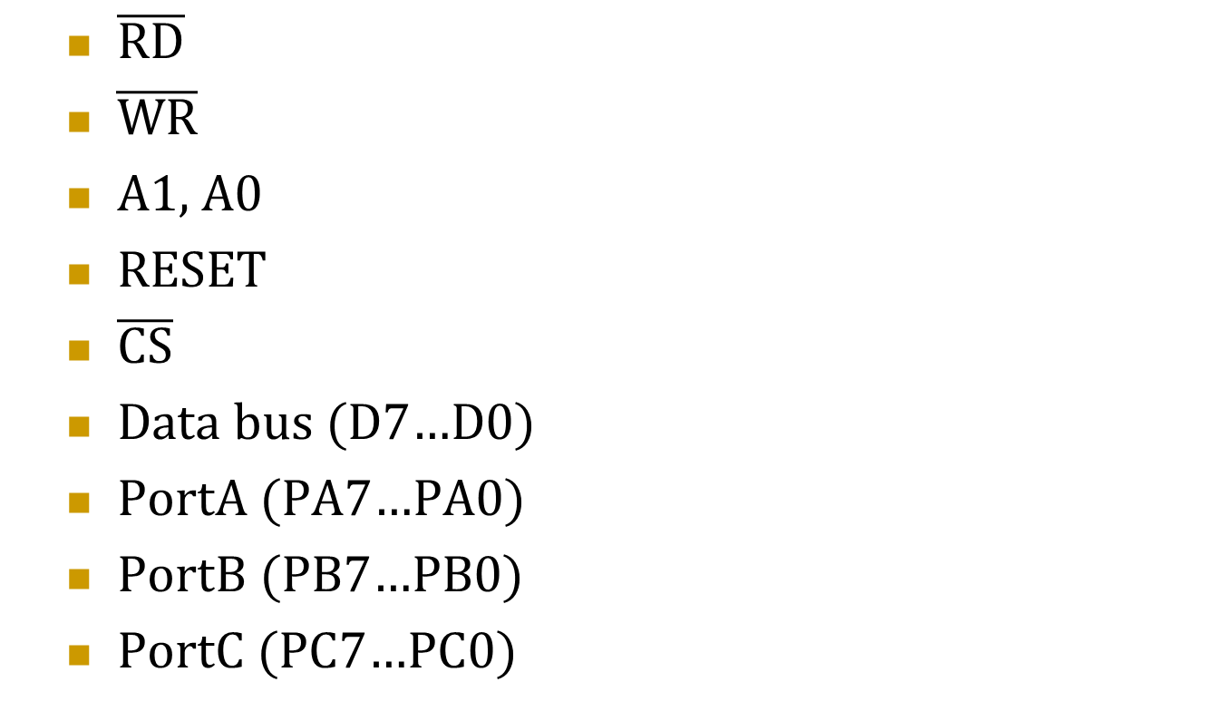
Important pins of PPI
$\overline{RD}$
$\overline{WR}$
A1, A0
RESET
$\overline{CS}$
Data bus (D7…D0)
PortA (PA7…PA0)
PortB (PB7…PB0)
PortC (PC7…PC0)

Slide 7
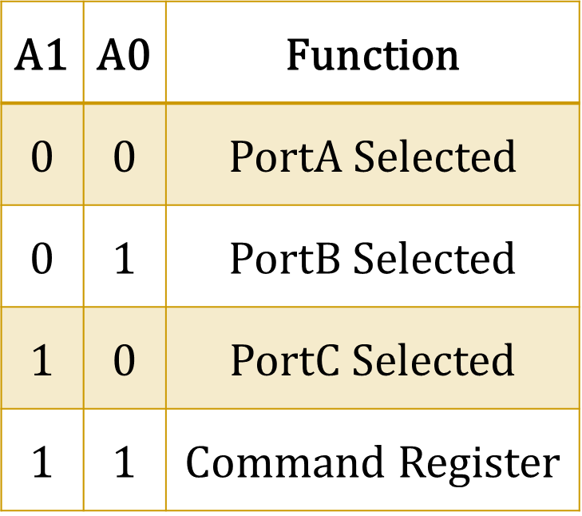
I/O Ports Assignment
Writing into this register programs the various ports to operate in various modes and be used as either inputs or outputs

Slide 8
Groups of PPI Lines
Group A is Port A and upper ½ of Port C (PC7-PC4).
Group B is Port B and lower ½ of Port C (PC3-PC0).

Slide 10
Lecture 3- Week 4

Slide 11
Programming PPI
Using one internal register
• If bit 7 = 1 select format for Command Byte A
• If bit 7 = 0 select format for Command Byte B
Bit 7 = 1: Command Byte A:
• Programs Groups A and B (as defined
in terms of ports A, B, C - previous slide):
- as either inputs or outputs
- in either modes 0, 1, or 2

Slide 12
Programming PPI
Bit 7 = 0: Command Byte B:
• Sets (to 1) or Clears (to 0) the specified one
of 8 bits of port C (in modes 1 and 2)

Slide 13
PPI Modes
Mode 0 (for groups A & B)- the most commonly used mode: All 12 bits of the group are simple inputs or simple latched outputs
Mode 1 (for groups A & B)- is used occasionally to provide handshaking to an I/O device and operate asynchronously with the device. Most Port C bits are dedicated for handshake functions for the operation. A few are controlled separately using the Command byte B format for handshaking I/O.
Mode 2 (for group A only- Group B not used)- is a bidirectional mode for Port A only (Port B is not used). Port C provides handshaking signals.

Slide 15
To program the command register of the 82C55 and select operation use command byte A
For example, to program all the ports as outputs and in mode 0 (the most common mode) use: MOV AL,80H
MOV DX,COMMAND_PORT
OUT DX,AL
= C6H in slide 9

